Slide 1

Stanford Course Fall‘23: Creating Production Ready LLMs arxiv-search
Sharat Sripada

Slide 2
Introduction - arxiv search
Leverage pre-trained Large Language Models (LLM) for Information Retrieval (IR) tasks
Using techniques like fine-tuning - Low Ranking Adaptation/LoRA, Efficient fine tuning of quantized LLMs - qLoRA, Parameter efficient Fine Tuning/PEFT etc., prompt engineering and Retrieval Augmented Generation (RAG) fit custom data and build a personalized Question-Answer (QA)/Hybrid-search engine
Problem Statement
The space of LLMs/IR is evolving at a rapid pace and research papers is one way to stay up-to-date, learn about problems being solved and innovate. Using papers from arxiv.org for past six-months and a pre-trained LLM (OpenAI - ChatGPT-3.5)* the objective is to build a QA model and seek answers to questions like:
what is recent research in RAG
Explain PRAG
What is the title of the paper for PRAG
Explain KGR
What is the title of the paper for KGR
are there any references to local language models
what is local different from PEFT? (ask generic questions)
*trained on data till Jan’23
Notes:
PRAG – Private RAG
KGR – Knowledge graph retrieval

Slide 3


Information Retrieval using RAG
Extract, Translate, Load (ETL)
QueryAnswer
Gradio
Response
LLM
OpenAI - gpt-3.5-turbo-16k
CSVLoader
(LC)
Doc similarity
search
4
5
Source: arXiv dataset of papers (title/summary)since 05/23 related to LLM, IR etc.
Encoder
HF-Embedder (hkunlp/instructor-xl)
vectorDB
FAISS
RecursiveCharacterTextSplitter
(LC)
2
3
PromptTemplate
Args: Query, Docs retrieved from
FAISS-db,
template
(LC)
1
PromptTemplate (Eval)
Args: Query, Docs retrieved from
FAISS-db,
Eval-Template
(LC)
Request/response
Observability
LC – LangChain
FAISS – Facebook AI Similarity Search
RAG – Retrieval Augmented Generation
W&B - Weights and Biases
Notes:
Alternatives:
Langchain – LLaMA index
W&B – Prometheus/Grafana, Arize AI
Gradio/FastAPI – Gradio is built on top of Streamlit (web-framework as well)

Slide 4
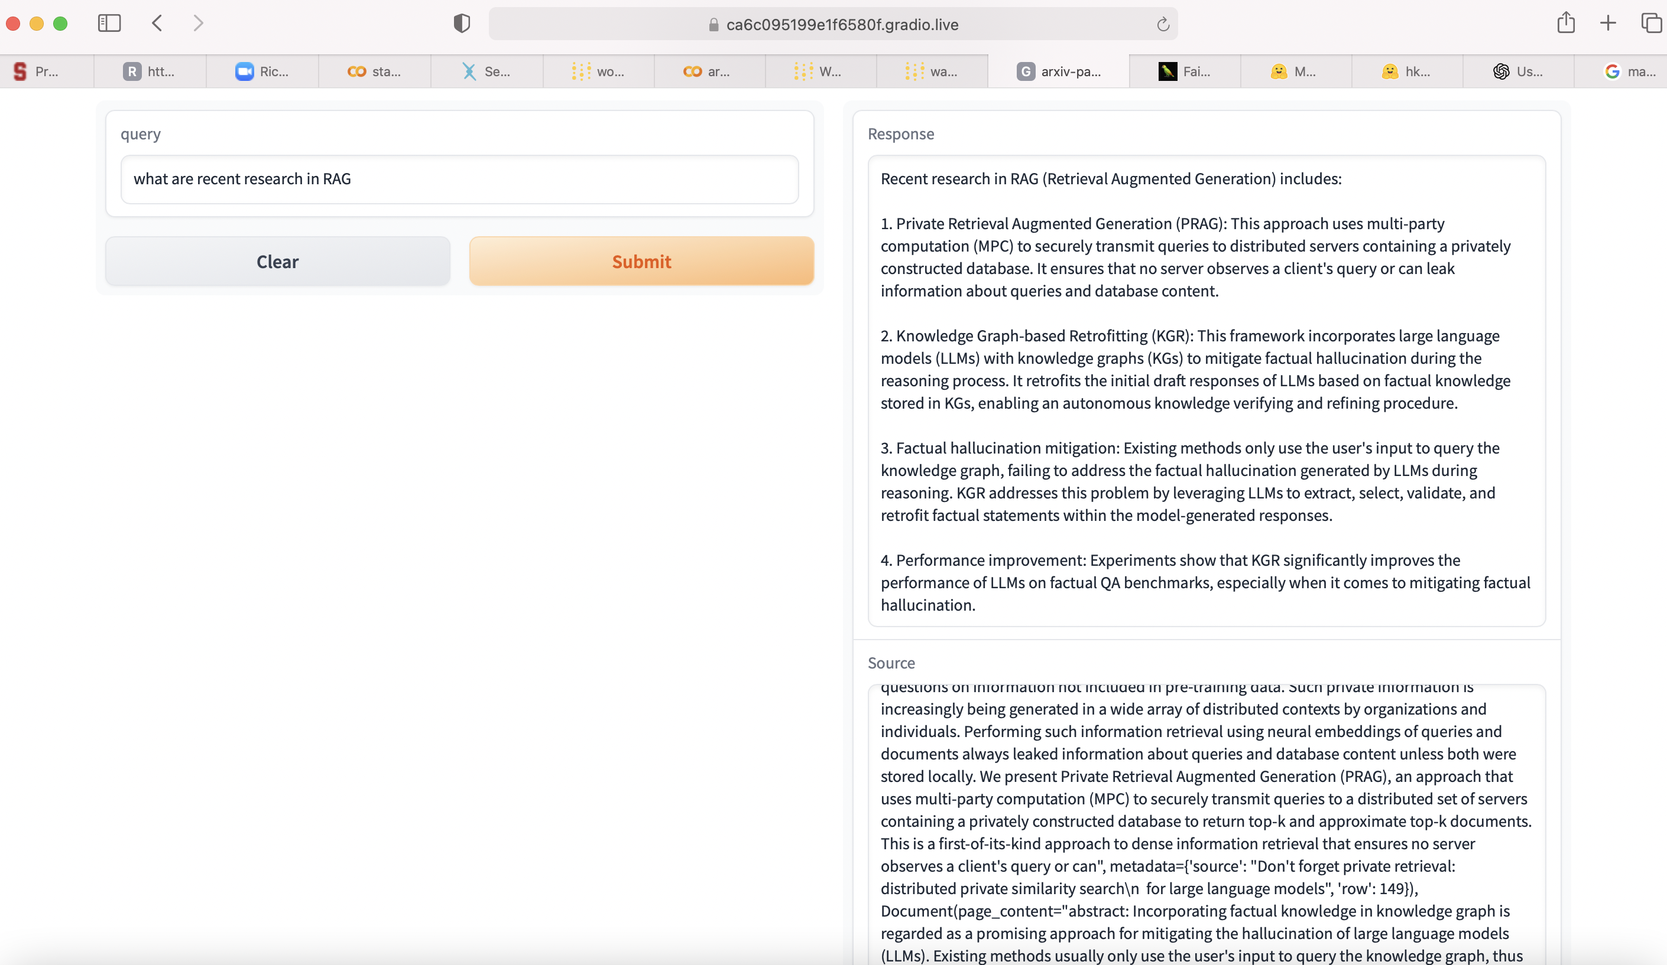
Demo arxiv-search - “What’s research community thinking about RAG”

Slide 5
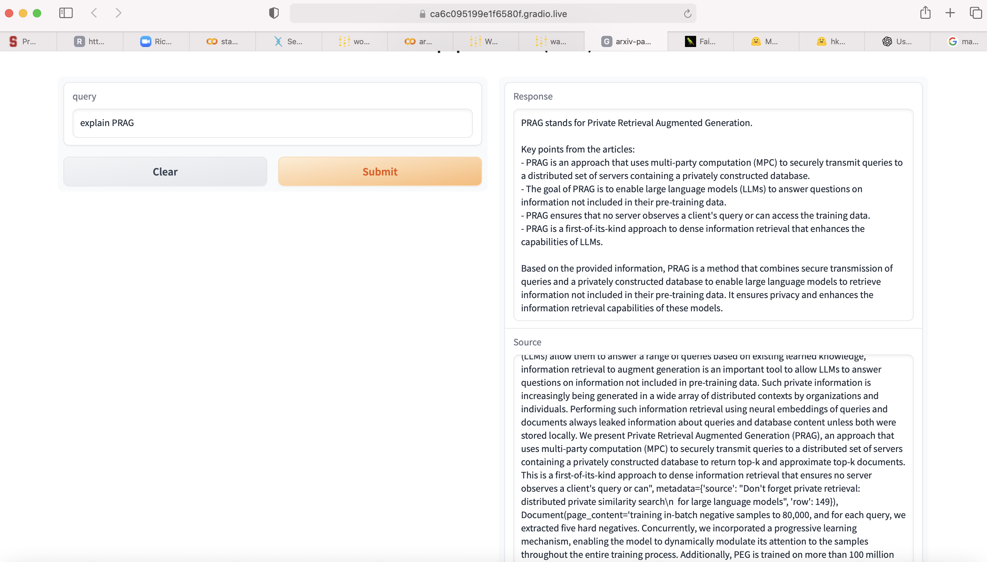
arxiv-search - “PRAG, ok. Ask more about PRAG before I dive in”

Slide 6
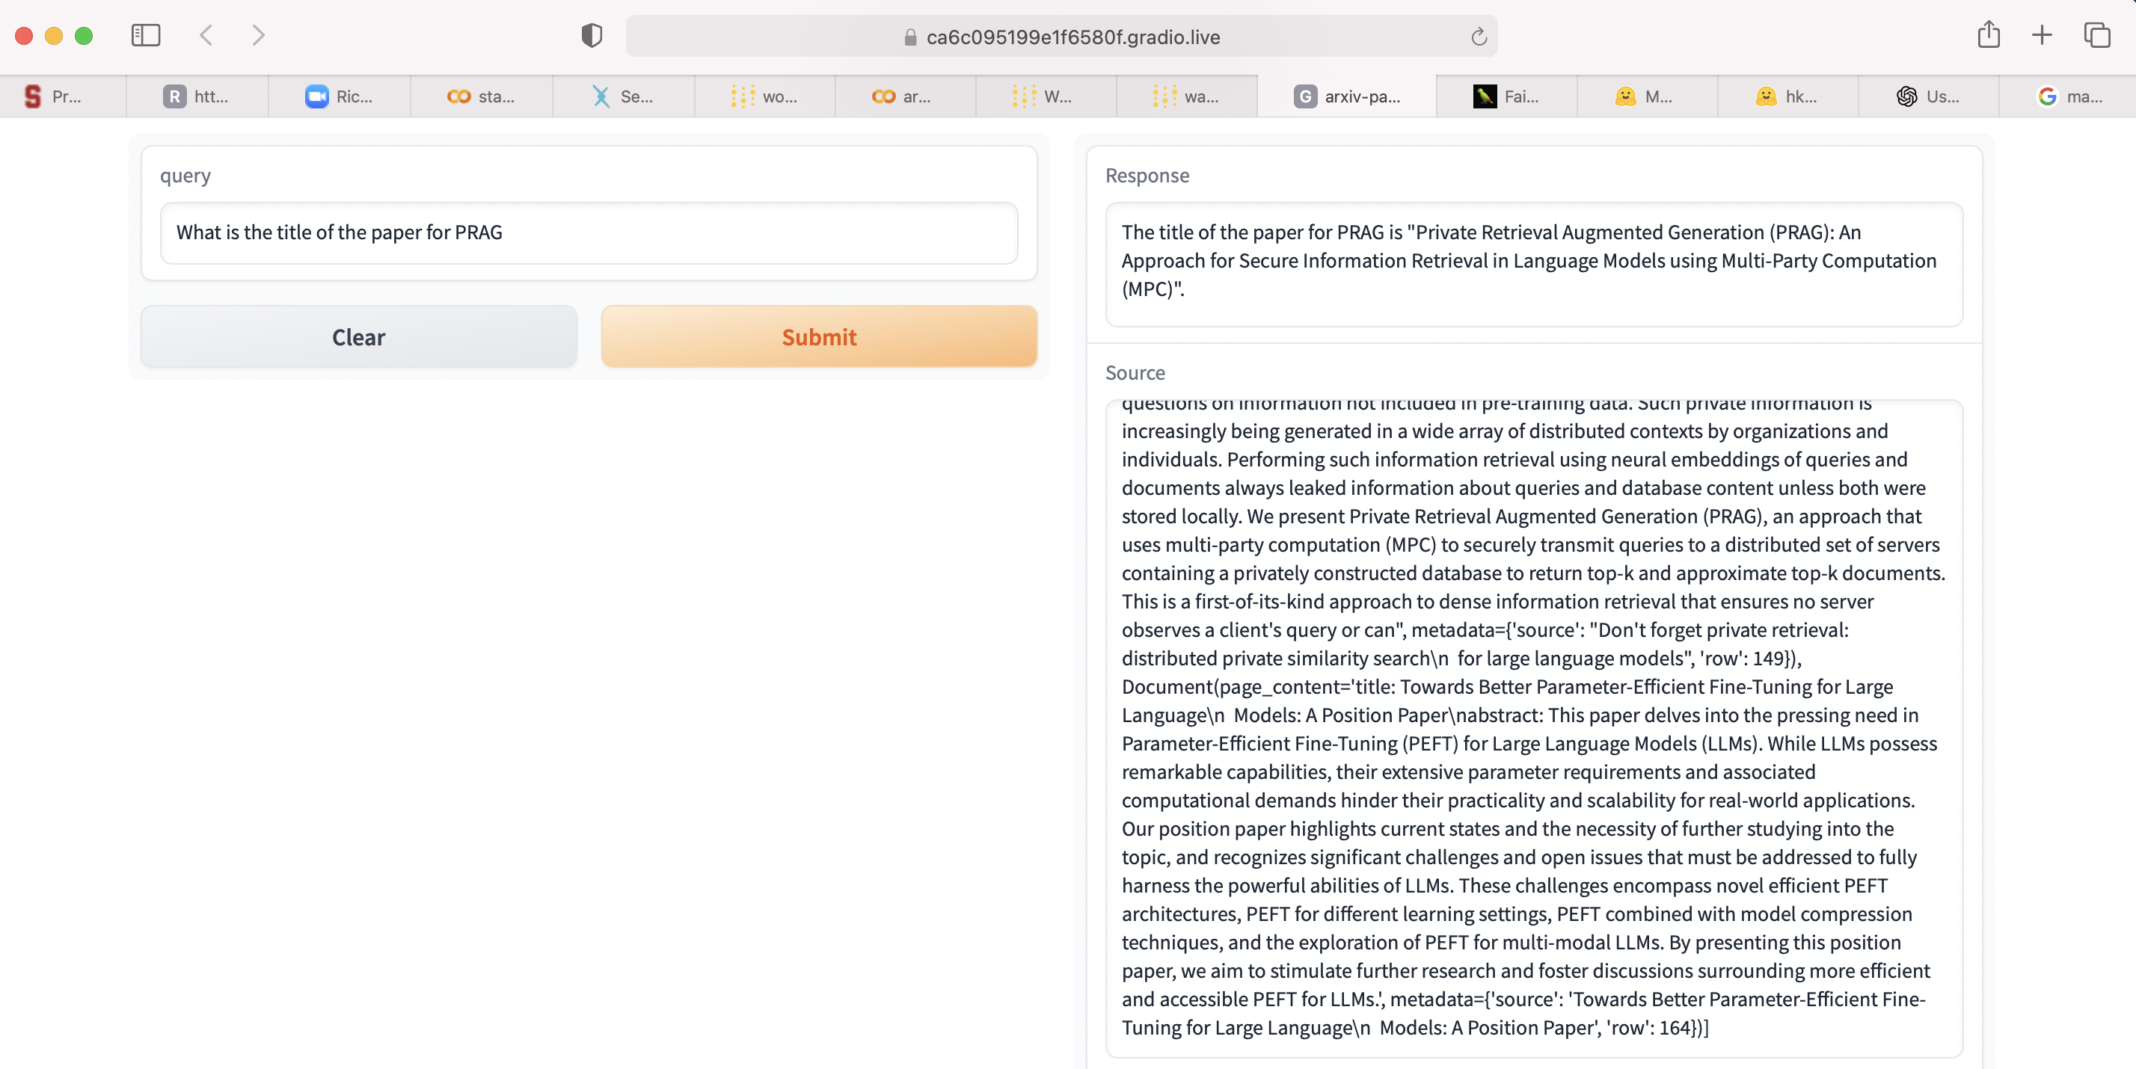
arxiv-search - “I like PRAG..give me the reference title/paper”

Slide 7
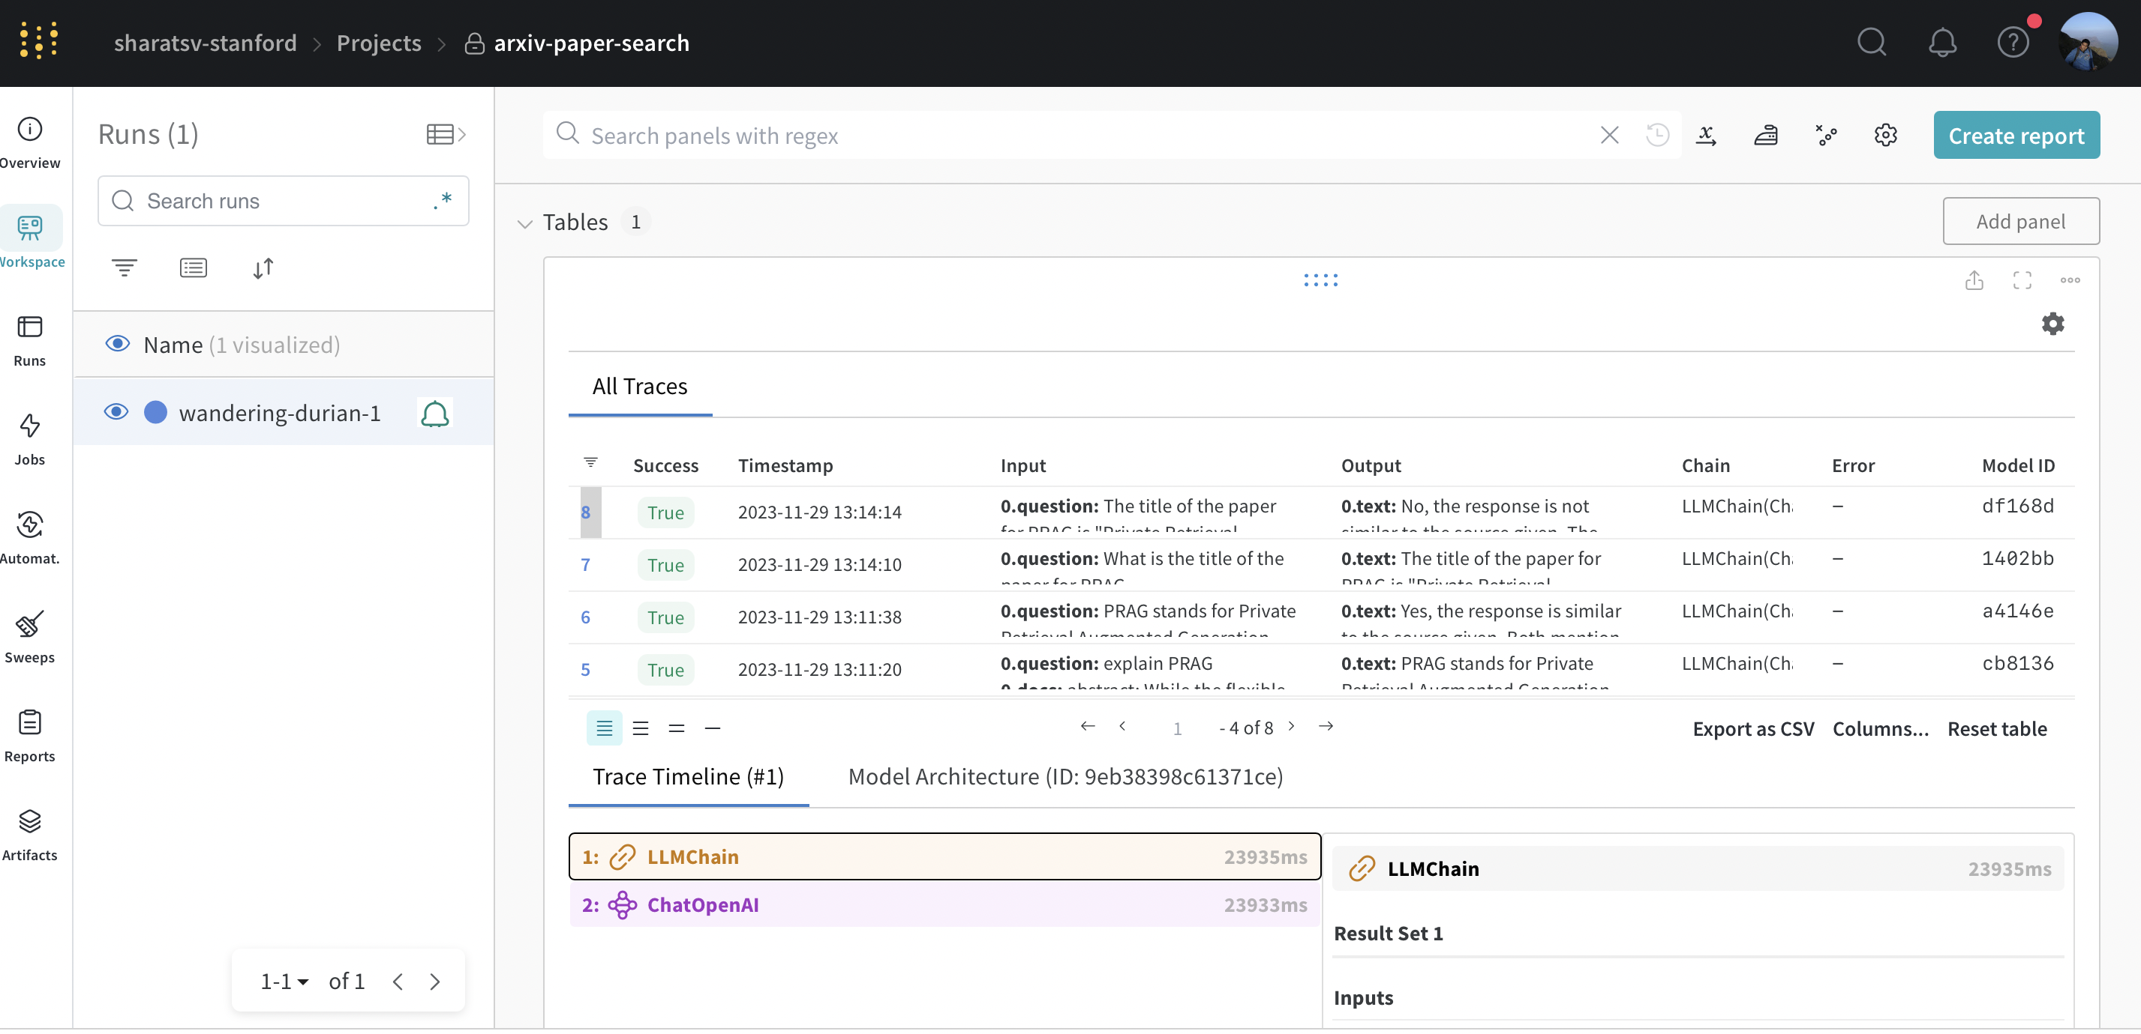
“Monitor infrastructure/GPU, query-response time..”

Slide 8
Future work
Host LLM (example: LLaMA-cpp) locally on a small form-factor like Raspberry-Pi/Rock-Pi
Experiment with Fine-tuning using LoRA/qLoRA versus RAG
Improve query-response time (to < 1sec)
Explore fetching summary of PDF/paper to QA model like:
what are recent research in RAG? (works)
what is the title of the paper? (works)
fetch the corresponding paper and summarize it (TBD)
Feedback from Cohort

